Slide 1
Chapter 6
NEW EFFICIENT ALGORITHM FOR SYNTHESIZING QUANTUM ARRAYS THAT USES A SINGLE ADDITIONAL ANCILLA QUBIT

Slide 2
New algorithm with a single ancilla bit
Main ideas:
Algorithm has two stages.
First stage uses global optimization using ESOP minimization.
Second stage uses reversible correction gates for the remainder functions.
The first stage approximates each output function separately with an ESOP of products of literals
Next it calculates the remainder function
The second stage realizes the second stage as it has many separated self-mapping minterms.

Slide 3
INPUT |  |  |  | OUTPUT
a | b | c | d | A | B | C | D
0 | 0 | 0 | 0 | 0 | 0 | 1 | 0
0 | 0 | 0 | 1 | 1 | 1 | 0 | 0
0 | 0 | 1 | 0 | 1 | 0 | 0 | 0
0 | 0 | 1 | 1 | 1 | 1 | 0 | 1
0 | 1 | 0 | 0 | 0 | 0 | 0 | 0
0 | 1 | 0 | 1 | 1 | 0 | 0 | 1
0 | 1 | 1 | 0 | 0 | 1 | 1 | 0
0 | 1 | 1 | 1 | 1 | 1 | 1 | 1
1 | 0 | 0 | 0 | 1 | 0 | 1 | 0
1 | 0 | 0 | 1 | 1 | 0 | 1 | 1
1 | 0 | 1 | 0 | 1 | 1 | 1 | 0
1 | 0 | 1 | 1 | 0 | 1 | 0 | 0
1 | 1 | 0 | 0 | 0 | 1 | 0 | 1
1 | 1 | 0 | 1 | 0 | 0 | 1 | 1
1 | 1 | 1 | 0 | 0 | 0 | 0 | 1
1 | 1 | 1 | 1 | 0 | 1 | 1 | 1
Number of Yellow Cells per column : 10/16 8/16 8/16 4/16
Table 6.2.1. Reversible function to be synthesized in this chapter, highlighted cells to indicate that input and output for that particular bit is different

Slide 4
Definition 6.1.
Exor-separable function is a function that can be expressed in the form:
V_{i} = vi ⊕ F(v1,..,vi-1, vi+1,…vn),
where
vi is its own primary input variable vi
and
function F is not a function of input vi and is a function of any subset of remaining variables from certain finite set of variables.

Slide 5
Main ideas
Two main stages.
The first stage of the method realizes approximately each of the output functions in the exor-separable form:
V_{i} = vi ⊕ F(v1,..,vi-1, vi+1,…vn).
This formula means that a function is an exor of its own primary input variable vi and certain function of ( a subset of ) other primary inputs but not input vi.
This means that this function can be realized as an ESOP initialized by vi and next built from Feynman and Toffoli gates all with EXOR in line vi-V_{i}.
If the original function can be represented in this form, then the realization V_{i} = vi ⊕ F(v1,..,vi-1, vi+1,…vn) is not an approximation but a function itself.
So no correction function needs to be built for it.
This is good, so if possible we should find as many such output functions as possible.

Slide 6
Main ideas cont
In most cases, however, especially for completely specified functions, the original function V_{i} (v1, v2, ,,, vi,… vn) cannot be represented as above and the ESOP-minimized function is found to become some approximation of function V_{i}.
There are many ESOP forms that approximate this function.
Again it is not clear which particular ESOP approximation is best, so I propose to use one that minimizes the HD.
But it is an open issue, as there are many approximations with the same HD value.
This way, the reversible function is separated to two stages.
The first stage are ESOP approximation functions and the second stage are combined together all remainder (residue) functions controlled by the single ancilla bit introduced to be used only in this stage.
Thus the second stage of the method adds one ancilla bit to the cascade width to realize the reminder function of each output function.

Slide 7
First function
Figure 6.2.1. (a) A four-variable K-Map for output variable “A”.
The pink (horizontal) group represents the input variable “a”. The green (vertical) group represents variable “d” which is exored using a Feynman gate with variable “a”.
Variable “d” was selected in order to “realize” as many true minterms as possible.
Let us observe that with this choice, true minterms 0001, 0011, 0101, 0111, 1000 and 1010 as well as false minterms 1101, 1111and 1011 are realized.
Observe that the remaining minterms, 0010, 1001, 1100, and 1110 should be realized in the reminder of this function.
(b) the KMap of function a⊕d found by ESOP minimizer as an approximation,
(c) the reminder function found by EXORing functions from Fig. 6.2.1a and Fig. 6.2.1b.

Slide 8
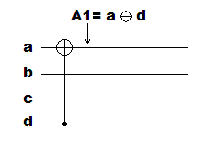
Figure 6.2.2. The circuit under realization after creating the first gate, A1=a ⊕ d.

Slide 9
INPUT1
A1 | b | c | d
0 | 0 | 0 | 0
1 | 0 | 0 | 1
0 | 0 | 1 | 0
1 | 0 | 1 | 1
0 | 1 | 0 | 0
1 | 1 | 0 | 1
0 | 1 | 1 | 0
1 | 1 | 1 | 1
1 | 0 | 0 | 0
0 | 0 | 0 | 1
1 | 0 | 1 | 0
0 | 0 | 1 | 1
1 | 1 | 0 | 0
0 | 1 | 0 | 1
1 | 1 | 1 | 0
0 | 1 | 1 | 1
Table 6.2.2.
The truth table of the remainder function where the inputs are A1, b, c and d and the outputs are 1 for all yellow minterms, and zero otherwise.
This function has only four yellow rows, which means four true minterms to be realized in the first quantum wire a-A.
# of Yellow Cells: 4/16

Slide 10
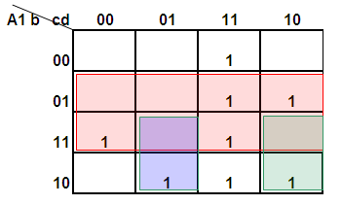
Figure 6.2.3. A K-Map for variable “B”. The horizontal pink group represents the input variable “b”.
The green group at right represents product group “A1cd’”,
The purple group at left bottom is product group ttom is A1c’d”,
Observe that with this choice, true minterms 0111, 0110,1100,1111,1001,1010 as well as false minterms 0100,0101,110 and 1110 are realized.
Observe that the remaining minterms, 0011,0100, 0101and 1011 should be realized in the reminder of this function.

Slide 11
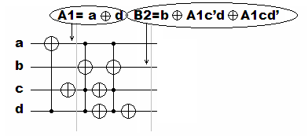
Figure 6.2. 4. The beginning of the circuit after realizing first two iterations of the first stage of the algorithm.

Slide 12
INPUT2
A1 | B2 | c | d
0 | 0 | 0 | 0
1 | 1 | 0 | 1
0 | 0 | 1 | 0
1 | 0 | 1 | 1
0 | 1 | 0 | 0
1 | 0 | 0 | 1
0 | 1 | 1 | 0
1 | 1 | 1 | 1
1 | 0 | 0 | 0
0 | 0 | 0 | 1
1 | 1 | 1 | 0
0 | 0 | 1 | 1
1 | 1 | 0 | 0
0 | 1 | 0 | 1
1 | 0 | 1 | 0
0 | 1 | 1 | 1
# of Yellow Cells: 4/16 4/16
Table 6.2.3. The truth table of the remainder function where the inputs are A1, B2, c and d and the outputs are 1 for all yellow minterms, and zero otherwise.
This function has only four yellow cells in column B2, which means four true minterms to be realized in the second quantum wire b-B.

Slide 13
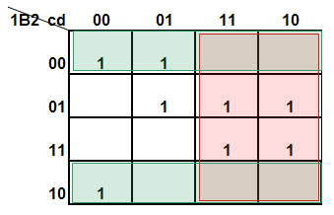
Figure 6.2.5. A K-Map for variable “C”.
The pink vertical group represents the input variable “c”.
The green cells represent variable “B2’”,
Observe that with this choice, true minterms 0000, 0001, 0111, 0110, 1111, 1110 and 1000 as well as false minterms 0011,0010,1011and 1010 are realized.
Observe that the remaining minterms, 0101 and 1001 should be realized in the reminder of this function.

Slide 14
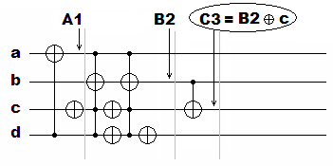
Figure 6.2.6. The beginning of the circuit after realizing first three iterations of the first stage of the algorithm.

Slide 15
INPUT3
A1 | B2 | C3 | d
0 | 0 | 1 | 0
1 | 1 | 0 | 1
0 | 0 | 0 | 0
1 | 0 | 0 | 1
0 | 1 | 0 | 0
1 | 0 | 1 | 1
0 | 1 | 1 | 0
1 | 1 | 1 | 1
1 | 0 | 1 | 0
0 | 0 | 1 | 1
1 | 1 | 1 | 0
0 | 0 | 0 | 1
1 | 1 | 0 | 0
0 | 1 | 0 | 1
1 | 0 | 0 | 0
0 | 1 | 1 | 1
# of Yellow Cells:
4/16 4/16 2/16
Table 6.2.4. The truth table of the remainder function where the inputs are A1, B2, C3 and d and the outputs are 1 for all yellow minterms, and zero otherwise.
This function has only two yellow rows in column C3, which means two true minterms to be realized in the third quantum wire c-C.

Slide 16
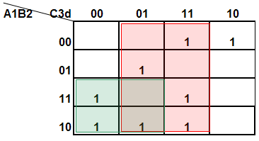
Figure 6.2.7. A K-Map for variable “D”.
The pink group (vertical) represents the input variable “d”.
The green group at left represents group “A1C3’”,
Observe that with this choice, true minterms 0011, 0101, 1100, 1111, 1000 and 1011 as well as false minterm 1101 are realized.
Observe that the remaining minterms, 0001, 0010, 0111, and 1001 should be realized in the reminder of this function.

Slide 17
INPUT4
A1 | B2 | C3 | D4
0 | 0 | 1 | 0
1 | 1 | 0 | 0
0 | 0 | 0 | 0
1 | 0 | 0 | 0
0 | 1 | 0 | 0
1 | 0 | 1 | 1
0 | 1 | 1 | 0
1 | 1 | 1 | 1
1 | 0 | 1 | 0
0 | 0 | 1 | 1
1 | 1 | 1 | 0
0 | 0 | 0 | 1
1 | 1 | 0 | 1
0 | 1 | 0 | 1
1 | 0 | 0 | 1
0 | 1 | 1 | 1
# of Yellow Cells: 4/16 4/16 2/16 4/16
Table 6.2.5. This is the truth table that is the input data to the second stage of the presented stage of the algorithm

Slide 18
Separation of minterm mappings to self-mappings
Table 6.2.6. Separation of minterm mappings to self-mappings denoted by “ –“ and non-self-mapping minterms denoted by “V”.
In this example the number of self-mapping minterms was increased in the first stage from one (Table 6.2.1) to five (this table).

Slide 19
Figure 6.2.9. Part of the circuit after adding MX1.

Slide 20
Figure 6.2.10. Next part of the circuit after adding MX2.

Slide 21
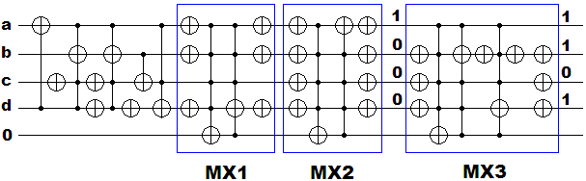
Figure 6.2.11. The circuit after adding MX3.

Slide 22
Figure 6.2.12. Part of the circuit after adding MX4.

Slide 23
Figure 6.2.13. Part of the circuit after adding MX5.

Slide 24
Figure 6.2.14 The internal construction of block MX6.

Slide 25
Figure 6.2.15. The construction of block MX7 before the optimization

Slide 26
Figure 7.2.16 The construction of block MX8.

Slide 27
Figure 6.2.17. The construction of block MX9.

Slide 28
Figure 6.2.18. The construction of block MX10.

Slide 29
Figure 6.2.19. The construction of block MX11.

Slide 30
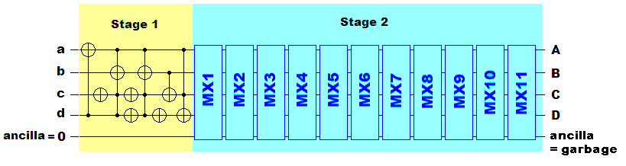
Final circuit obtained with the new method
Figure 6.2.20. The composition of all blocks.

Slide 31
New Variants:
Different variants of this algorithm can be created by controlling the following:
Controlling the order of variables in stage 1,
Controlling how many times to repeat stage 1 before going to stage 2,
Controlling the control variables in stage 1 (product of variables)
Designing the MXs to be able to transform more than one minterm per MX.

Slide 32
Variant with a global correction function
All non-self-mapping minterms can be combined and realized together as shown in Figure 6.2.21.
This will replace the first part of all correction gates from second stage with just one gate realizing the function CORRECTION in ancilla bit,
where CORRECTION = 1 ⊕ B1 C3 ⊕ A1 B1 D4’ ⊕ A1 C3 D4’, as shown by ESOP groups in Figure 6.6.21.
Figure 6.2.21. Realization of a global correction function for the second stage.

Slide 33
6.3. Conclusions on CORREV
CORREV = ( CORrection based REVersible synthesizer )
different from all algorithms in the literature.
a new concept of correction function based on one ancilla bit.
generic
can be modified and upgraded in various ways.

Slide 34
The advantages of CORREV are the following:
It uses the ESOP minimizer software of very high quality of optimization,
thus it includes a global minimization method for every qubit separately.
Global optimization was missing in all previous approaches.
CORREV has the freedom to select the qubits of the array in arbitrary order when it creates the approximating functions.
This allows for various selection orders at each step, which combined with various ways of controlling ESOP minimize allows to create new variants in every run of the algorithm.
The longer the program will be run, the better solutions it will potentially find.

Slide 35
CORREV uses correction gates library.
These gates can be optimized once forever and next reused.
They can be optimized using MMD or any other software.
Two variants of correction gates exist, one with their own recognition part and output part, and other with only the output part.
In the second case the ESOP minimize is used to create the global correction function.
CORREV can be combined with any ESOP minimizer that it calls for minimization of subfuctions.
By processing of its stages CORREV may call various logic synthesis tools.
Current concept of CORREV adds just one ancilla bit.
We found on several examples that adding just one ancilla significantly reduces the length of the cascade.
I will consider having two or three ancilla bits to see what improvement it may bring.

Slide 36
CORREV algorithm always converges because the number of non-self-mapping minterms to be realized in the second stage is finite.
Therefore in finite number of steps all correction gates for the second stage can be constructed.
The second stage of CORREV can be minimized using any algorithm for synthesis of reversible logic.
Thus MMD, MMDS and all our algorithms presented in previous chapters can be used.
Various tricks and heuristics discussed in chapters 4 and 5 and related to use of special gates can be added to CORREV algorithm.

Slide 37
The CORREV algorithm can work with incomplete data specifications as ESOP minimizer works with them.
This is a big advantage of CORREV as when functions have many don’t cares the algorithm has much freedom to realize many functions in the first stage as:
EXOR-separable functions,
Functions close to EXOR-separable functions (small HD, etc),
which makes the remainder functions to include few minterms and have a small Hamming Distance.
Each stage can be realized with any algorithm.
More than two stages are possible.
As the first stage increases the number of self-mapping minterms, iterating the first stage may further increase the number of self-mapping minterms.
When all minterms after repetitions of stage 1 become self-mapped, the algorithm terminates.

Slide 38
One of CORREV variants is to use the synthesis method for the first stage repeatedly to see if the number of minterm pairs reduces in each iteration.
Instead of using ESOP minimizer for every single-output function, we can use minimization methods for affine gates, PPRM circuits or any other method discussed in previous chapters.
In case of Multiple-Valued logic, chapter 8, we can use this algorithm with any MV CAD tool to synthesize gates in the first stage or distance gates (blocks) in the second stage.
The trouble is only that we do not dispose a high quality GFSOP minimize as such CAD tool has been not constructed yet.
At this point I see only one disadvantage of my approach – programming of the algorithm to include many of these methods may be complicated.
At first I will implement only the basic version of the algorithm and I will compare it with MMD and the algorithm of Agrawal/Jha.

